Slide 1
Knowledge Marketing
Rest service design for Email Marketing with web api 2.2

Slide 2
Conceptual Design
Follow REST principles where practical. (GET, POST, PUT, DELETE)
Search is a special case; it supports only GET with one method for each other controller
API methods are the thinnest possible wrapper around the Business Layer
Where possible, validation is delegated to the Business Layer.
Exposed objects (API Model Objects) are subsets of existing Business Layer Object (“Business Objects”)
Response statuses following HTTP conventions; payloads are delivered in terms of API Model Objects or -in the case errors- an object with the associated HTTP Status Code and a “friendly” error message.
Design-time configuration (Errors, Search) are handled by custom “singleton” static classes.
Cross-cutting concerns (Authentication & Logging) are handled via globally applied Attributes
Request scoped commonality is centralized in a custom base-class.

Slide 3
High-Level Design

Slide 4
HTTP Headers
For all request, a custom header called “APIAccessKey” is required
For responses, PUT and POST set a “Location” header containing the URI for the subject of the action.

Slide 5
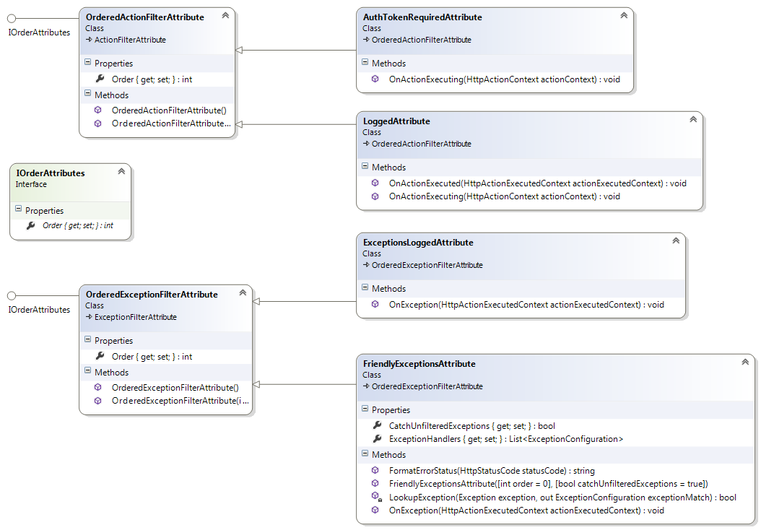
Attributes
Cross Cutting Concerns

Slide 6
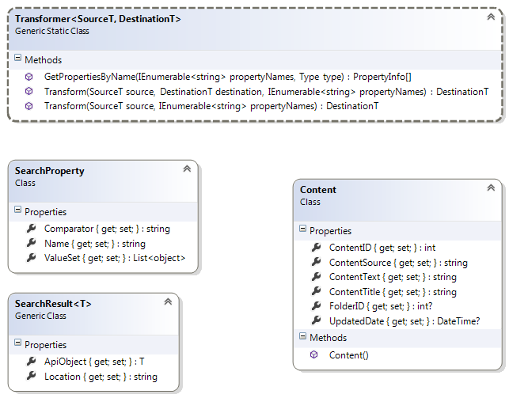
Models

Slide 7
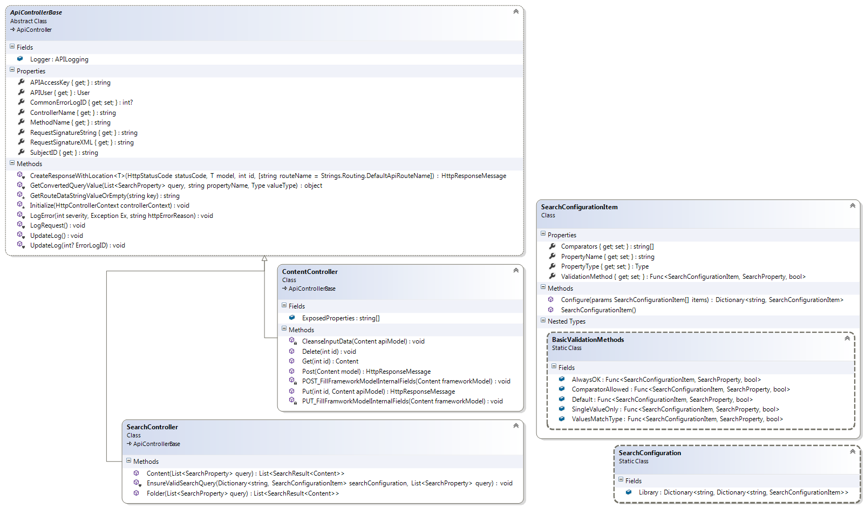
Controllers

Slide 8
Search Configuration

Slide 9
Error Responses
400-499 – Responses in this range indicate an error with the Request (e.g. 4xx codes)
problems will return something in the 4xx range.
4xx codes are transformed into “Friendly Exception Messages” internally according to a lookup table mapping specific exception types to delegates that generate context specific messages.
404 (“Not Found”) is an exception to this pattern; no message/additional information is provided.
500-599 – Indicate a problem with (or creating) a response.
500 “Internal Server Error” – generally, uncaught exceptions will return this code, while anticipated. These receive special handing, specifically adding a record to the Common error log and associating it back to the API Log entry for the request.

Slide 10
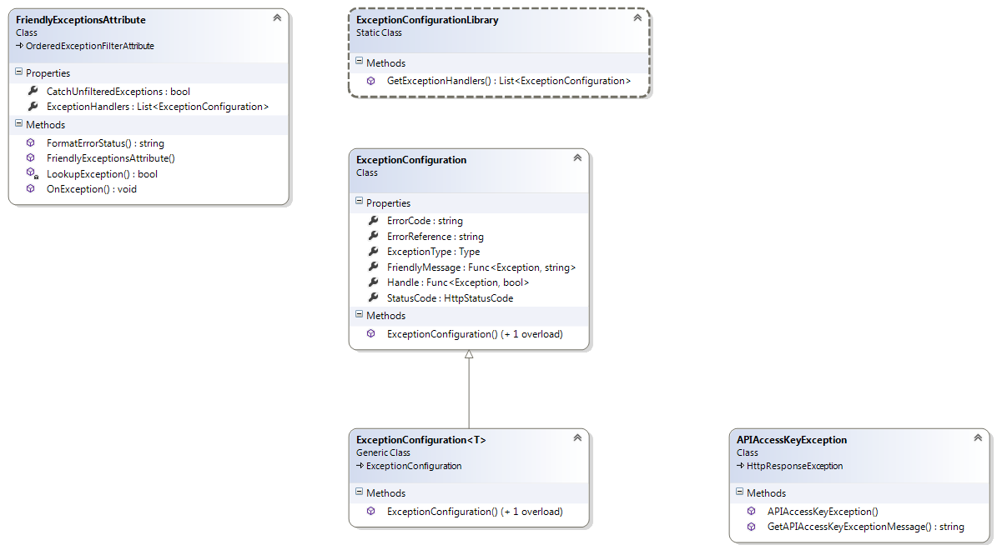
Errors

